Slide 1
Getting Started with the SharePoint Framework
Chris Kent
Office 365 Practice Lead, DMI

Slide 3















“Me”
Indianapolis, IN
Office Development
Office 365 Practice Lead
@theChrisKent
Member of the Core Team
theChrisKent.com
Notes:
Can I possibly get my name on a single slide even more? Wow.

Slide 4













Platinum Sponsors
Silver Sponsors
Speaker Dinner Sponsor
To all of our sponsors,
Thank you!
Gold Sponsors

Slide 5
Goals

Slide 6
SharePoint Framework
What | When | Why

Slide 7
SharePoint Framework Development
Setup | Tooling | Tips

Slide 8
Patterns & Practices
Samples | Guidance

Slide 10
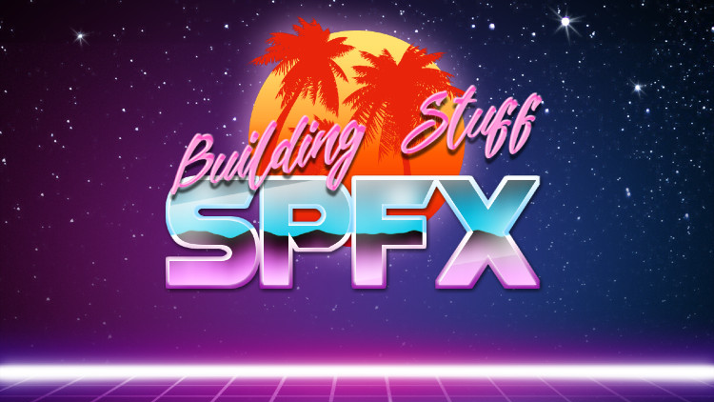

Slide 11
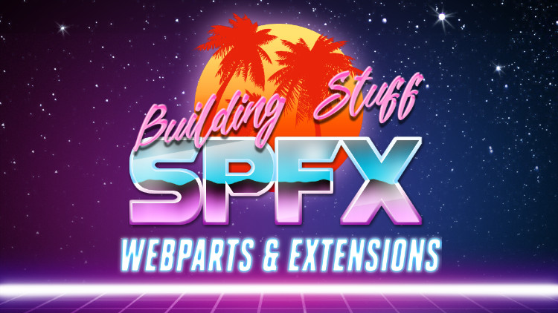

Slide 12
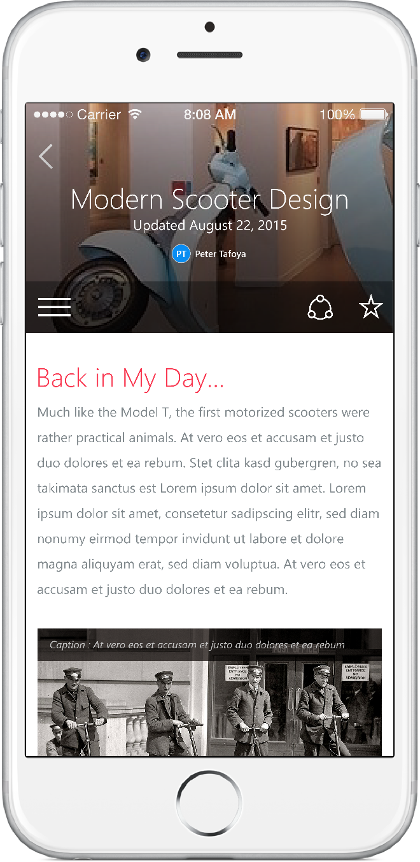
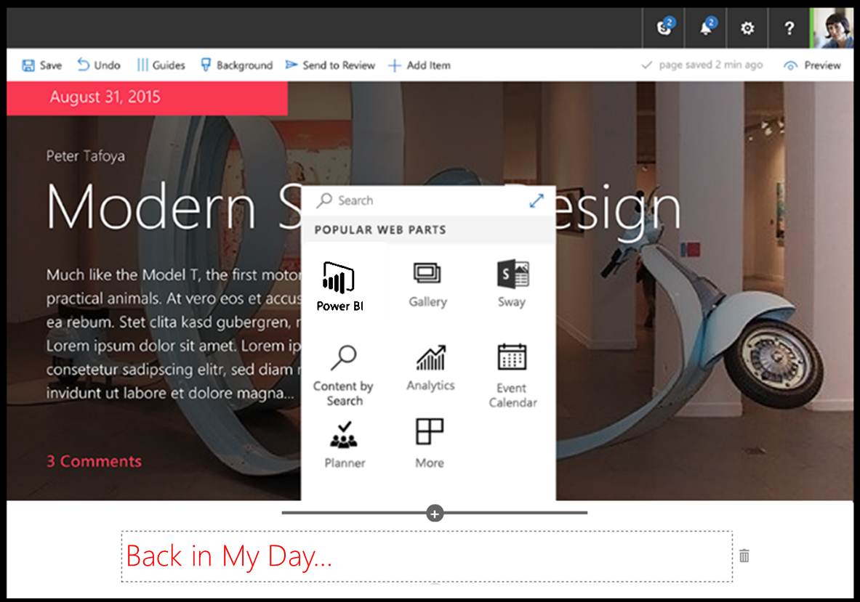
SharePoint Framework (SPFx)
Modern client-side development
Powers OOTB experiences
Supports open source tools and JavaScript web frameworks
Built to be Responsive
SharePoint Framework
Microsoft Graph
LOB Systems and Cloud Services

Slide 13
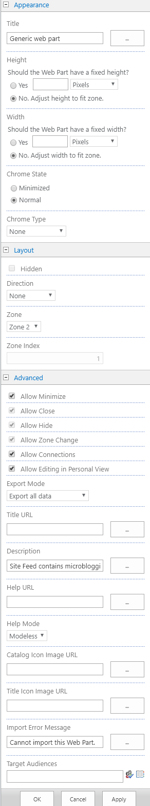
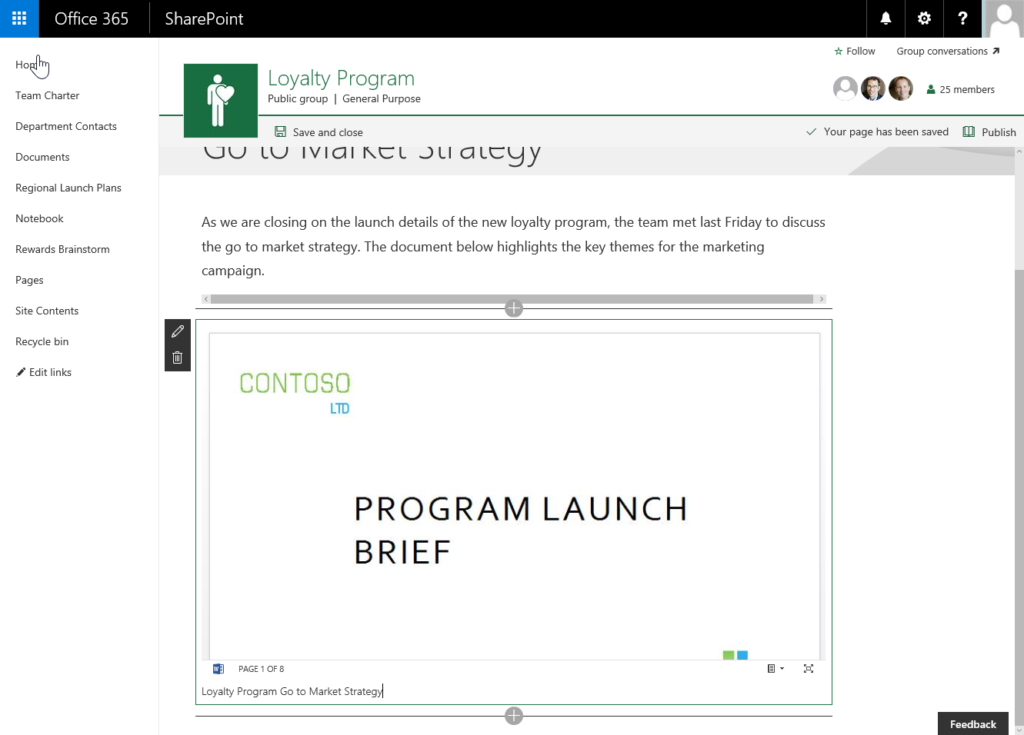

SPFx Web Parts
O365, 2016, & 2019
Modern Property Pane
Only YOUR properties
Instant application
Optional Apply button
Easily extensible
Multiple pages available
They are still web parts! (Mostly)

Slide 14
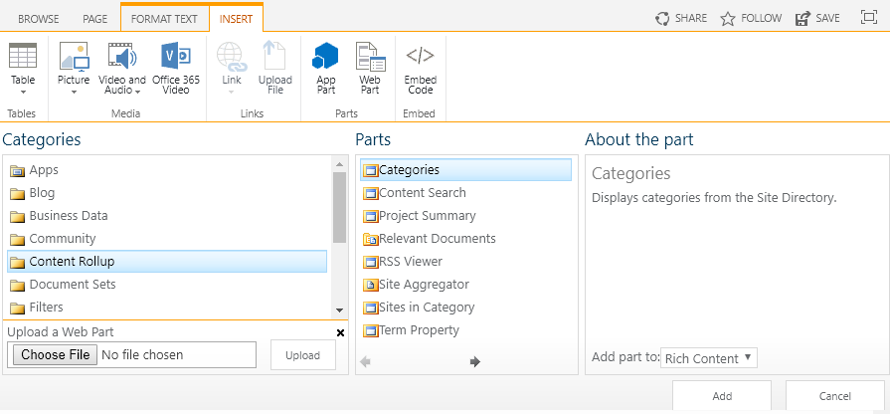
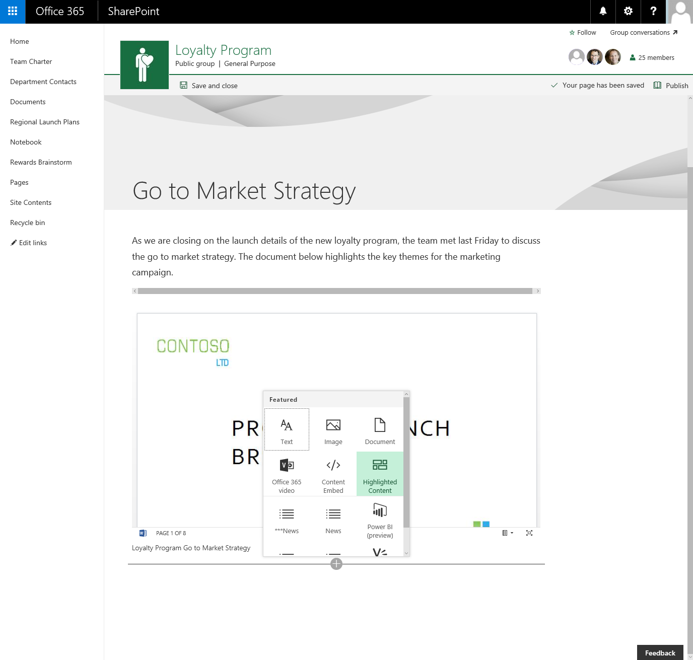
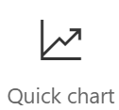
SPFx Web Parts
O365, 2016, & 2019
They are still web parts! (Mostly)
Built for the modern, JavaScript-driven web.

Slide 15
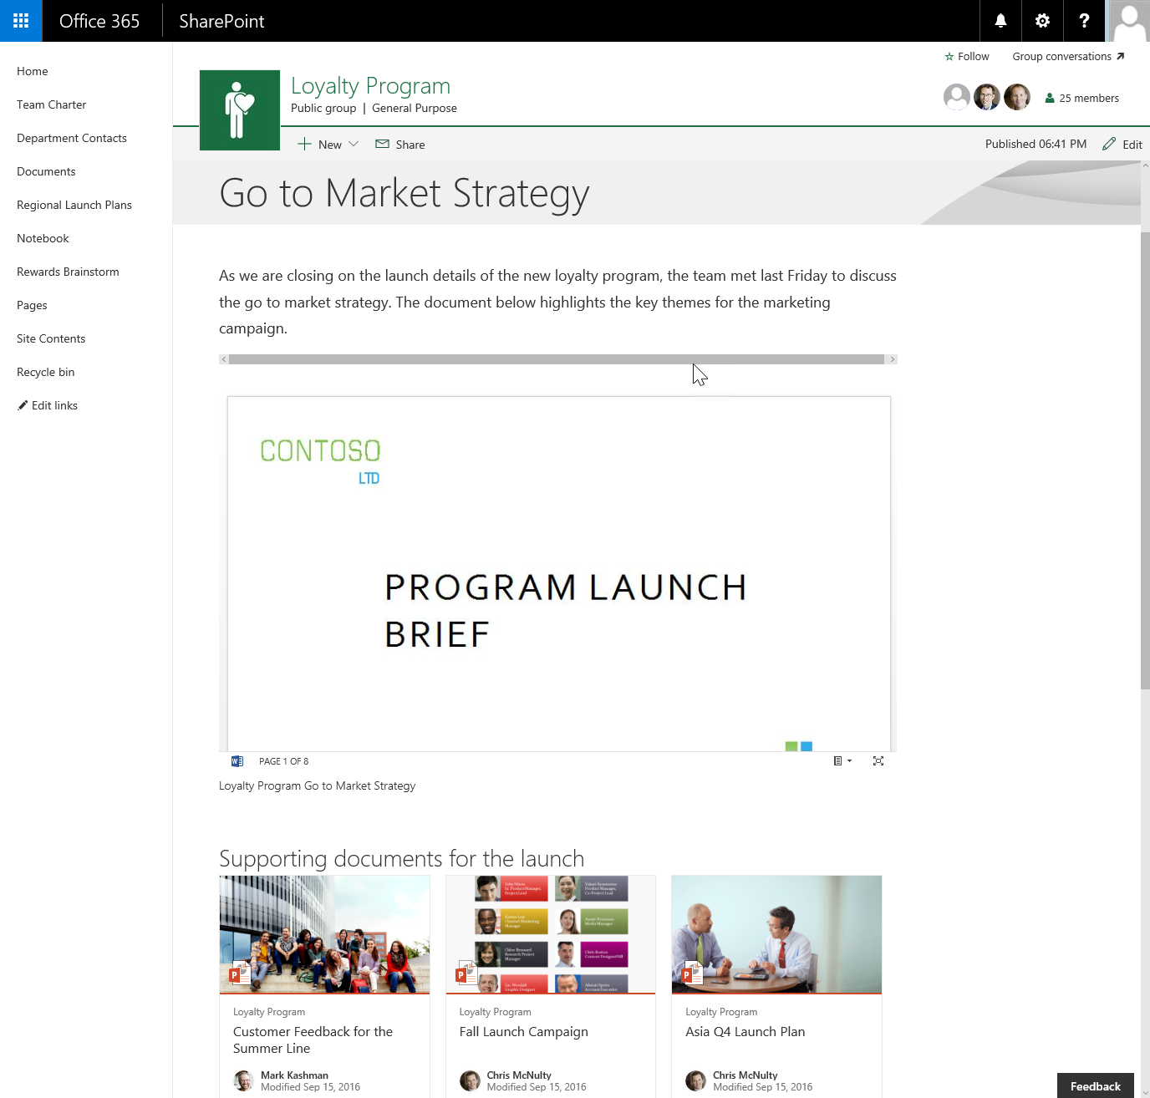
SPFx Web Parts
O365, 2016, & 2019
They are still web parts! (Mostly)
Built for the modern, JavaScript-driven web.
Runs directly inside a SharePoint Page.
(Even Classic pages)

Slide 16





SPFx Extensions
O365 & 2019
Modern UI Extensions
Modern pages only
3 Types
Application Customizer
ListView Command Set
Field Customizer
Added as Custom Actions
No visible UI for adding/configuring

Slide 17

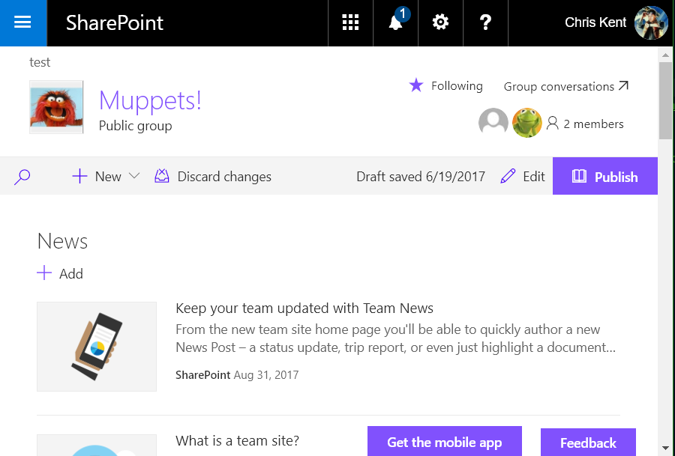

Application Customizers
SPFx Extension
Adds scripts to the page
Provides access to Placeholders
Top
Bottom

Slide 18
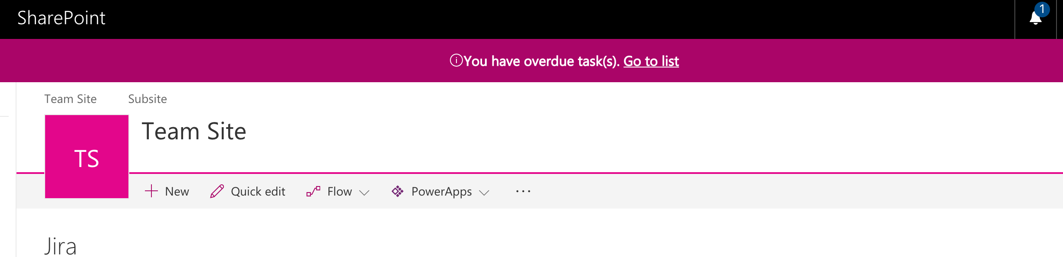
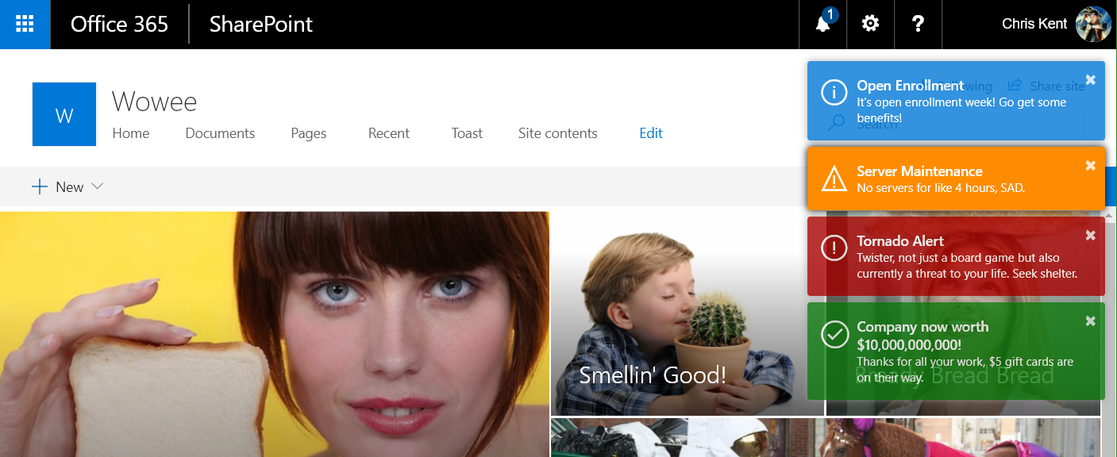
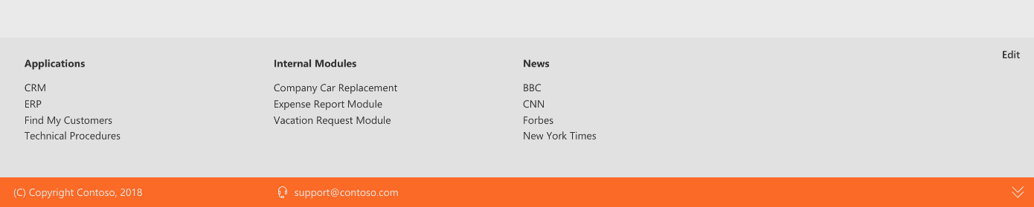
Application Customizers
SPFx Extension
Adds scripts to the page
Provides access to Placeholders
Top
Bottom

Slide 19

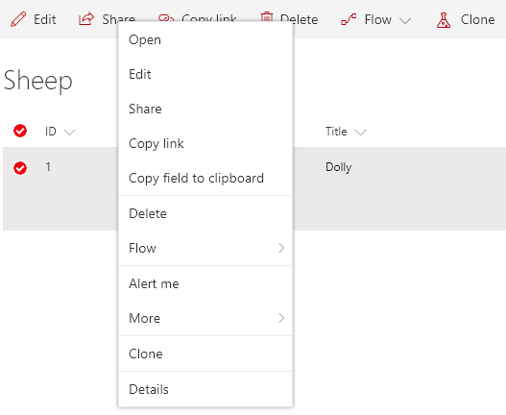
ListView Command Sets
Adds 1 or more Commands to a modern List View
Commands can be added to:
Context Menu
ClientSideExtension.ListViewCommandSet.ContextMenu
Command Bar
ClientSideExtension.ListViewCommandSet.CommandBar
Both
ClientSideExtension.ListViewCommandSet

Slide 20
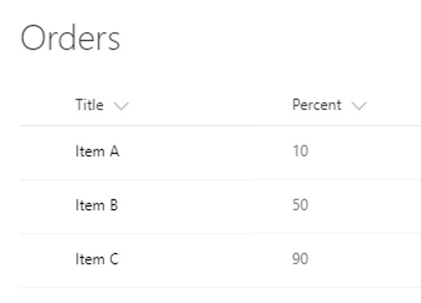
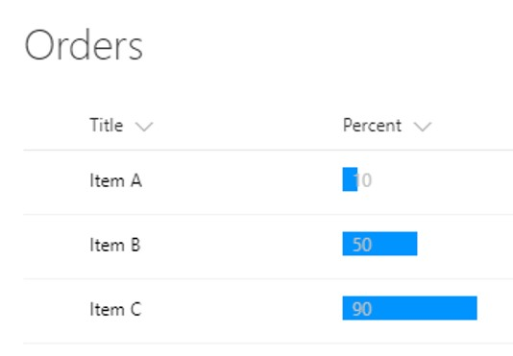

Field Customizers
SPFx Extension
Customize the display of a field in a list view

Slide 21
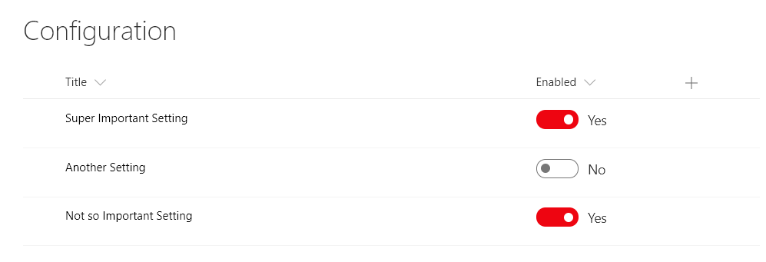
Field Customizers
SPFx Extension
Customize the display of a field in a list view

Slide 22
Column Formatting vs Field Customizer
Customization | Column Formatting | Field Customizer
Conditional Formatting based on item values | Supported | Supported

Slide 23
Column Formatting vs Field Customizer
Customization | Column Formatting | Field Customizer
Conditional Formatting based on item values | Supported | Supported
Action Links | Static links (no script) | Any type of link

Slide 24
Column Formatting vs Field Customizer
Customization | Column Formatting | Field Customizer
Conditional Formatting based on item values | Supported | Supported
Action Links | Static links (no script) | Any type of link
Visualizations | Simple Visualizations (HTML & Styles) | Whatever!

Slide 25
Column Formatting vs Field Customizer
Customization | Column Formatting | Field Customizer
Conditional Formatting based on item values | Supported | Supported
Action Links | Static links (no script) | Any type of link
Visualizations | Simple Visualizations (HTML & Styles) | Whatever!
Page Context | @now, @me, window size | Full context!

Slide 26
Column Formatting vs Field Customizer
Customization | Column Formatting | Field Customizer
Conditional Formatting based on item values | Supported | Supported
Action Links | Static links (no script) | Any type of link
Visualizations | Simple Visualizations (HTML & Styles) | Whatever!
Page Context | @now, @me, window size | Full context!
JS Libraries | Nope | Go for it!
Custom CSS Classes | Nope, limited subset & inline styles | Go for it!
Interactivity | Nope | Go for it!

Slide 27

Column Formatting vs Field Customizer
Customization | Column Formatting | Field Customizer
Conditional Formatting based on item values | Supported | Supported
Action Links | Static links (no script) | Any type of link
Visualizations | Simple Visualizations (HTML & Styles) | Whatever!
Page Context | @now, @me, window size | Full context!
JS Libraries | Nope | Go for it!
Custom CSS Classes | Nope, limited subset & inline styles | Go for it!
Interactivity | Nope | Go for it!
Developer Required | “No” | Yes
Solution Deployment | Nope! | Required
Use Column Formatting when possible, but know it’s limits

Slide 28

SPFx Development

Slide 29





Tool Comparison
IIS Express
C#
MSBuild
Traditional
Project Templates
Dev Server
Templates
Packages
Editor
Language
Build Tasks
SPFx
VS Code

Slide 30

Tool Comparison
IIS Express
C#
MSBuild
Traditional
Project Templates
Dev Server
Templates
Packages
Editor
Language
Build Tasks
SPFx
VS Code

Slide 31


Slide 32


1. Install NodeJS LTS
https://nodejs.org
If already installed, check version with:
node -v .
If using a Mac, use homebrew to install and manage
Homebrew (Macs Only)
http://brew.sh
https://dev.office.com/sharepoint/docs/spfx/set-up-your-development-environment

Slide 33

2. Install VS Code
https://code.visualstudio.com
Recommended Extensions
Debugger for Chrome
VSCode Great Icons
Import Cost
Bracket Pair Colorizer
You can also use
Atom
Webstorm
Visual Studio
Notepad
Runs on Mac and Linux too
https://dev.office.com/sharepoint/docs/spfx/set-up-your-development-environment

Slide 34

3. Install Yeoman & Gulp
From a Command Prompt use this command:
npm install -g yo gulp .
You can also use the VS Code Terminal (View > Terminal)
http://yeoman.io
http://gulpjs.com
https://dev.office.com/sharepoint/docs/spfx/set-up-your-development-environment

Slide 35


4. Install the SPFx Generator
From a Command Prompt use this command:
npm install -g @microsoft/generator-sharepoint.
You can also use the VS Code Terminal (View > Terminal)
Same generator is used for O365, SP2016, & soon SP2019
https://dev.office.com/sharepoint/docs/spfx/set-up-your-development-environment

Slide 36
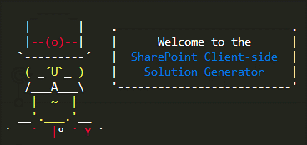
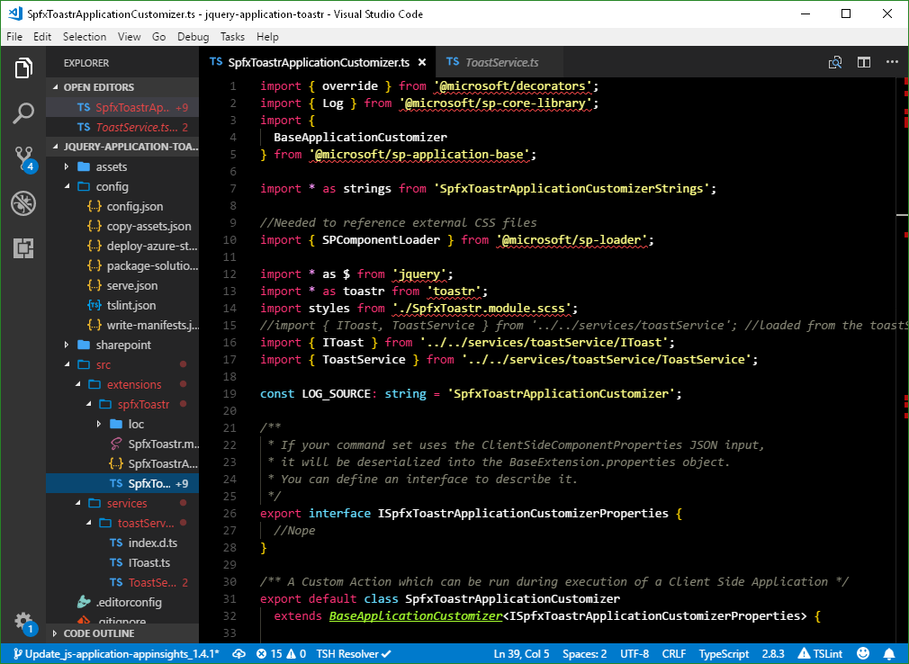
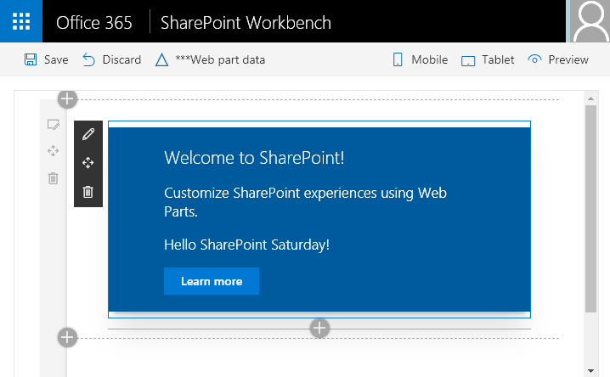

Generating a Solution
From the command line:
Answer the questions
A solution and a component (web part or extension) will be generated
Running the generator again in the same directory will just add additional components
Launch VS Code:
See it in Action:
yo @microsoft/sharepoint. .
code . .
gulp serve. .

Slide 37

Demo: Generating an
SPFx Solution
Notes:
From a command line:
md MySpecialWebPart
cd MySpecialWebPart
yo @Microsoft/sharepoint
Fill out the questions (React for Framework, yes to tenant deployment, yes to SP Online, current folder, etc.)

Slide 38
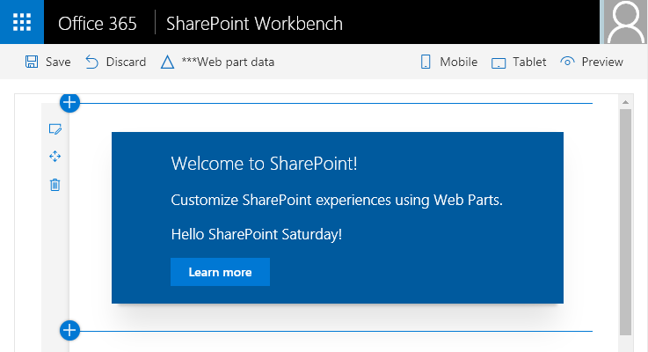
SharePoint Workbench
Local Workbench
Offline development
No more VMs
Auto Refresh
“Online” Workbench
O365, 2016, & 2019
Provides full context
_layouts/15/workbench.aspx
Web Parts Only
Extensions use serveConfigurations & live pages
https://thechriskent.com/2017/11/03/utilizing-spfx-serveconfigurations/

Slide 39

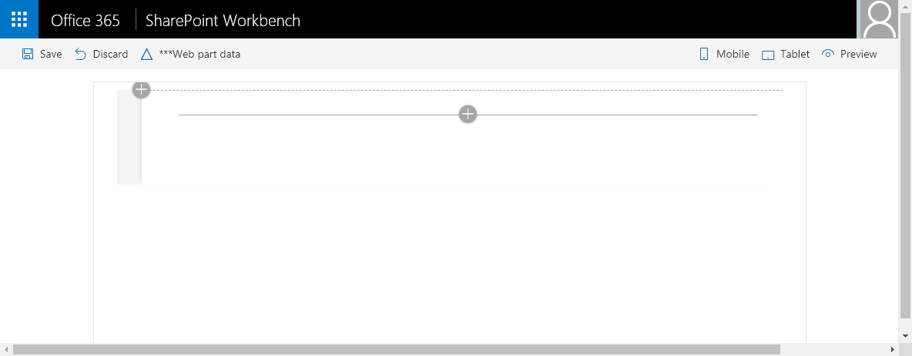
Anatomy of the SharePoint Workbench
Always Says Office 365
https://localhost:4321/temp/workbench.html
Fake Waffle
Fake User

Slide 40
Anatomy of the SharePoint Workbench
https://localhost:4321/temp/workbench.html
Add Your Web part
Mimics a Modern Page – Edit Mode by default

Slide 41
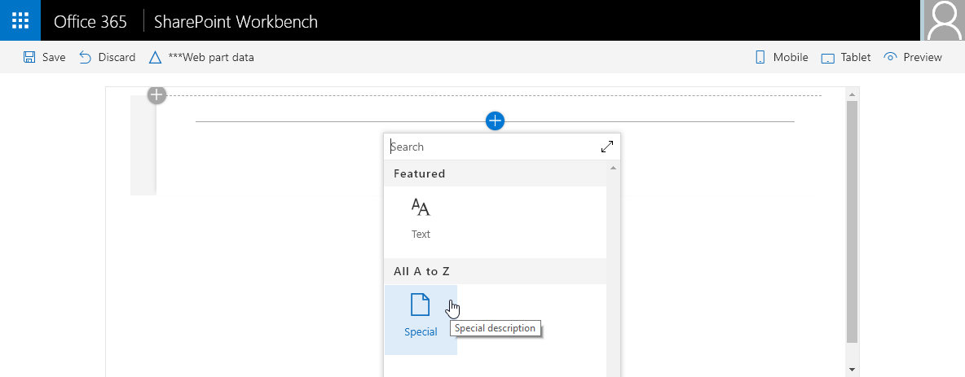
Anatomy of the SharePoint Workbench
https://localhost:4321/temp/workbench.html
Add Your Web part

Slide 42
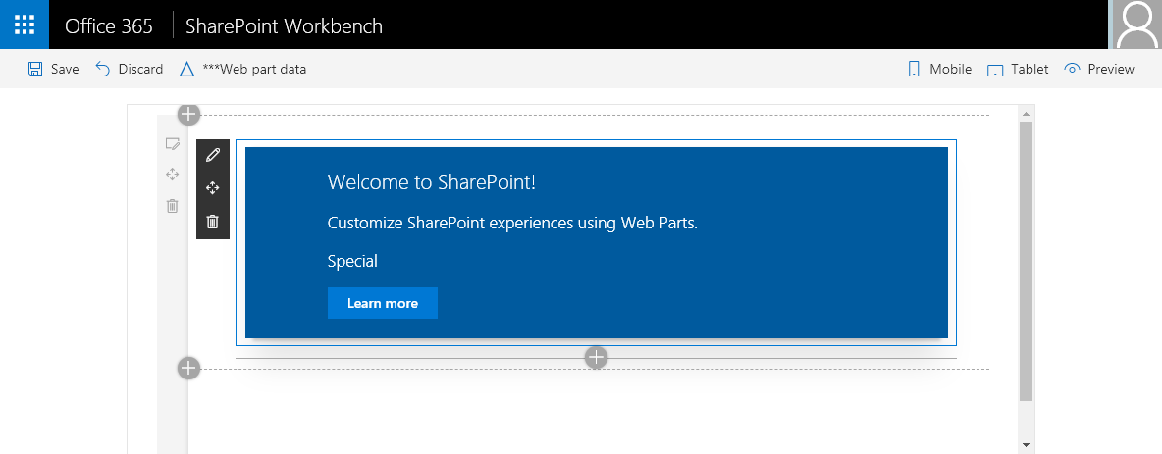
Anatomy of the SharePoint Workbench
Clear everything
https://localhost:4321/temp/workbench.html
Data Stuff
Switch to Display Mode
Properties
Edit the Section
Add a Section
Add other web parts

Slide 43
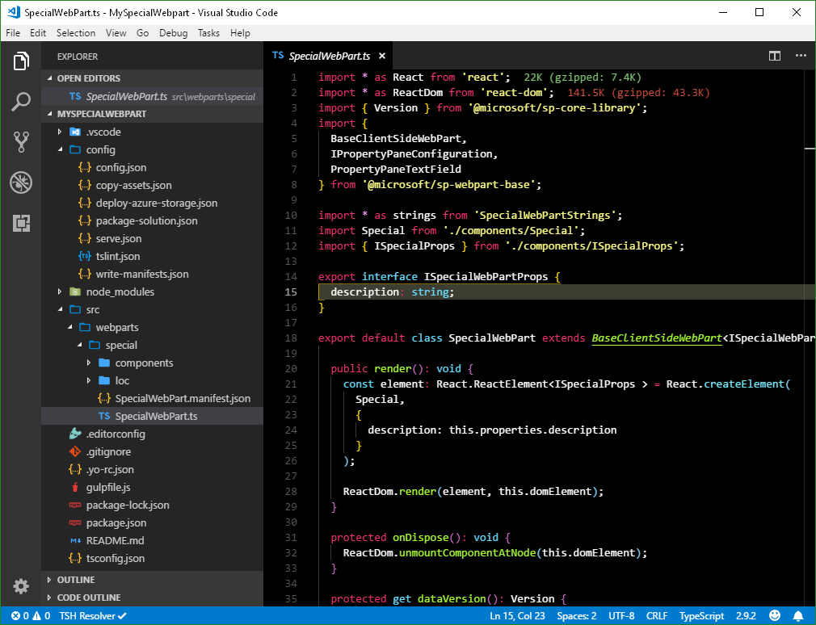
SPFx Solution Structure
VS Code
Launch with code .
Or right-click in folder
My Settings
Theme:
Monokai Contrast
Icons:
VSCode Great Icons
Extensions:
Bracket Pair Colorizer
Import Cost

Slide 44



SPFx Solution Structure
Externals,
Bundles
Solution name,
Version,
Asset deployment, Feature deployment,
Package name
Local workbench,
serveConfigurations (Extensions)

Slide 45


SPFx Solution Structure
Referenced Libraries
React Components
Web part name,
Web part description,
Web part icon,
Default property values,
Full Bleed support,
Searchable properties,
Tags,
Disable on Classic
Hide from Toolbox
Localized Strings
Defaults to en-us
Code Entry Point

Slide 46
SPFx Solution Structure
Extend Build Tasks
Dependencies
TypeScript Configuration

Slide 47

Demo: Building a
SPFx web part
Notes:
From the command line:
npm install @pnp/spfx-property-controls --save --save-exact
npm install @pnp/spfx-controls-react --save --save-exact
npm install @pnp/logging @pnp/common @pnp/odata @pnp/sp –save
code .
gulp serve
Demonstrate workbench & Property Pane
Ctrl-C to kill serve
Walk through basics of code
Change description property to listId
In ISpecialWebPartProps
In ISpecialProps
Update render method of web part to pass correct prop
Update render method of Special.tsx for correct prop
Add List Picker Property Pane Control (https://sharepoint.github.io/sp-dev-fx-property-controls/controls/PropertyFieldListPicker/)
Update icon to HeartFill in SpecialWebPart.manifest.json
remove default description property
gulp serve --nobrowser
Show local workbench with Mock data
Switch to online workbench https://thechriskent.sharepoint.com/sites/Special/_layouts/15/workbench.aspx
Add onConfigure property to ISpecialProps.ts
Show error
Add method to props in web part
Add placeholder to Special.tsx (https://sharepoint.github.io/sp-dev-fx-controls-react/controls/Placeholder/)
Show placeholder in action
Setup PnPJS (https://pnp.github.io/pnpjs/getting-started.html)
Add state interface
Update component to accept state interface
Add basic constructor
Add Spinner
Add specialBox class to styles
Import spinner
Replace content with Spinner (https://developer.microsoft.com/en-us/fabric#/components/spinner)
Show spinner
Add List Retrieval
Import pnpJS
Add Load Items method
add componentDidUpdate method
Add loadItems call to constructor

Slide 48
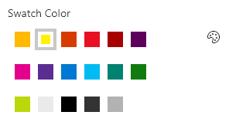
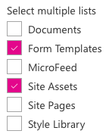
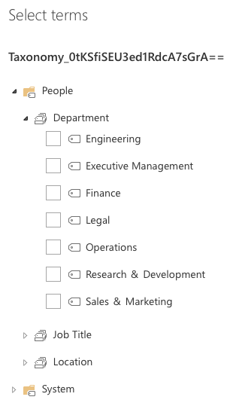
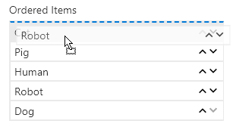
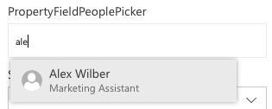
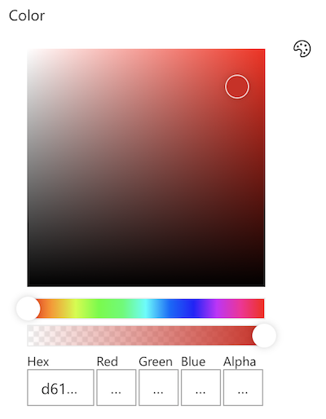
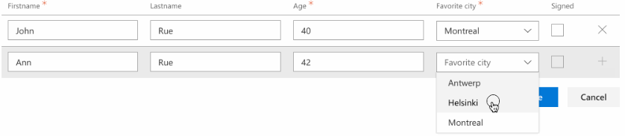
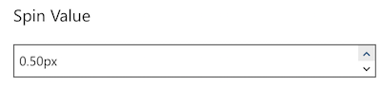
sharepoint.github.io/sp-dev-fx-property-controls
20+ Controls!
PnP Property Controls

Slide 49
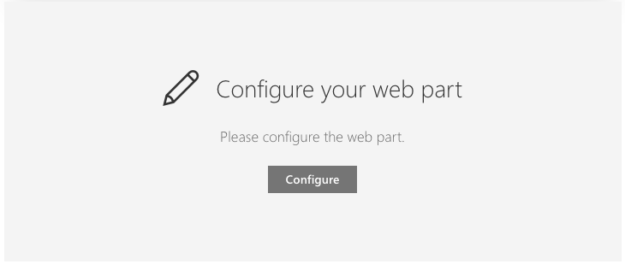
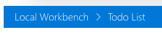
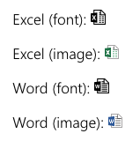
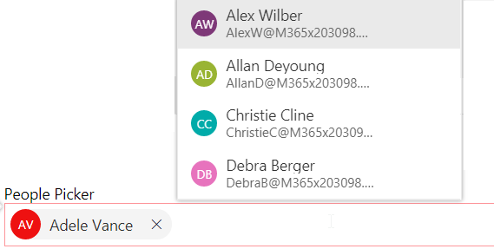
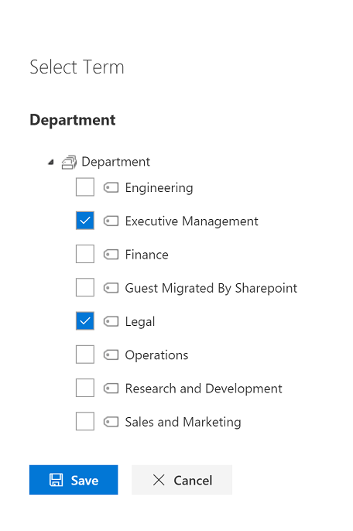
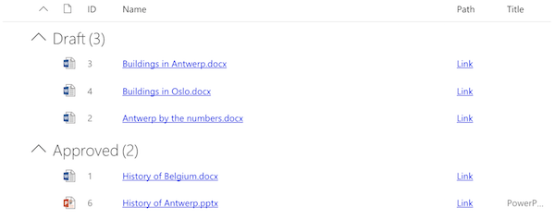
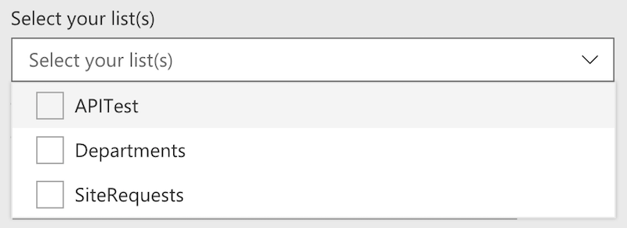
sharepoint.github.io/sp-dev-fx-controls-react
22+ Controls!
PnP React Controls

Slide 50











Office UI Fabric
Standardized Iconography, Fonts, & Colors
Responsive Grid System
Reusable Components
Powers OOTB Experiences
Fonts, icons
Colors
Components
Grid
Office 365 Consumers
SharePoint
Delve
Project
OneDrive
Office 365
Outlook

Slide 51


pnp.github.io/pnpjs
Fluent API
Batching
Caching
The best way to access the REST API via JS
PnPJS

Slide 52



Deployment
Generate a Bundle (single JS file)
Create a Package (Zip with Bundle & Manifest)
Upload to the App Catalog
Optionally, check box for Tenant Deployment
If Public CDN is enabled, it will be used
gulp bundle --ship. .
gulp package-solution --ship. .

Slide 53


Demo: Web part
Deployment
Notes:
gulp bundle --ship
gulp package-solution --ship
Navigate to package
sharepoint > solution
Drag package on to Apps for SharePoint in App Catalog
Check the box for tenant wide deployment
Deploy
Add to a page
Update the solution
Add the border color to the specialBox
gulp bundle --ship
gulp package-solution --ship
Navigate to package
sharepoint > solution
Drag package on to Apps for SharePoint in App Catalog
Replace
Check In

Slide 54
SharePoint Framework 1.6 - Current plan – ETA: end of July 2018
Schedule and content is subject to change
Planned to get released by end of July – 1.7 in Ignite timeframe
Tenant wide deployment of SharePoint Framework Extensions
GA of Graph and 3rd party API calls from SharePoint Framework
GA of Dialog Framework (still in beta)
Support for React 16
Preview of socket.io
SharePoint 2019 support (choosing the right version)
Other “things”… some surprises always there…

Slide 55
SharePoint 2019 – Dev Platform
Yes
No
Modern pages
Modern sites – Modern team and communication site
SharePoint Framework Extensions
Webhooks
Asset packaging (no CDN)
Column formatting
(Tenant scoped deployment)
(ALM APIs)
Site Designs
Hub sites
Site collection app catalog
“Tenant” properties
View Formatting
Preliminary plan, subject to change
SharePoint 2019 SharePoint Framework 3rd party version will be 1.4

Slide 56

aka.ms/sppnp

Slide 57


Slide 58


Bi-Weekly
SP General Development
aka.ms/sppnp-core-sig-call
PowerShell, Provisioning, CSOM
Next Call: Thursday, 8/9
Bi-Weekly
SharePoint Framework
aka.ms/sppnp-js-sig-call
SPFx, PnP JS Core
Next Call: Thursday, 8/2
Monthly
Community Calls
aka.ms/sppnp-call
Monthly Summary
Next Call: Tuesday, 8/13

Slide 59



Official Blog
dev.office.com/blogs
Twitter
@OfficeDevPnP
Tech Community
aka.ms/sppnp-community

Slide 60
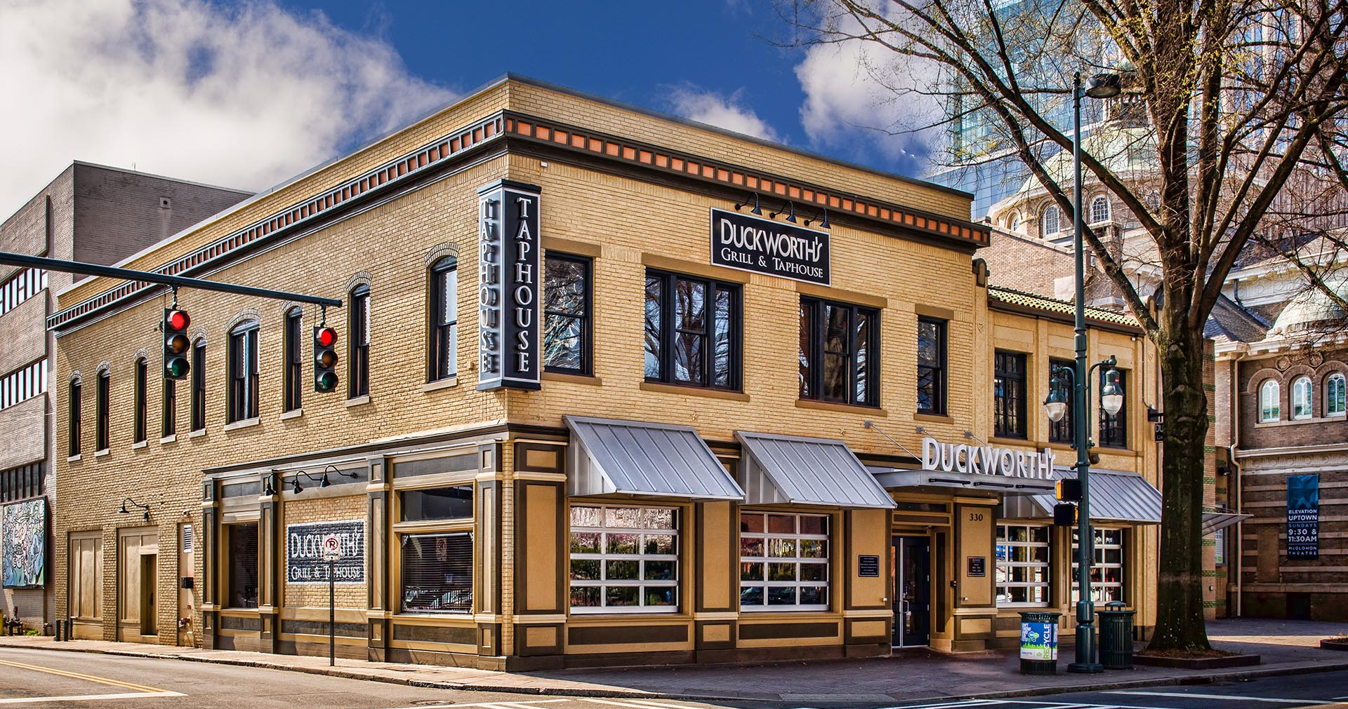
SharePint
Happy Hour after SPCLT

Slide 61
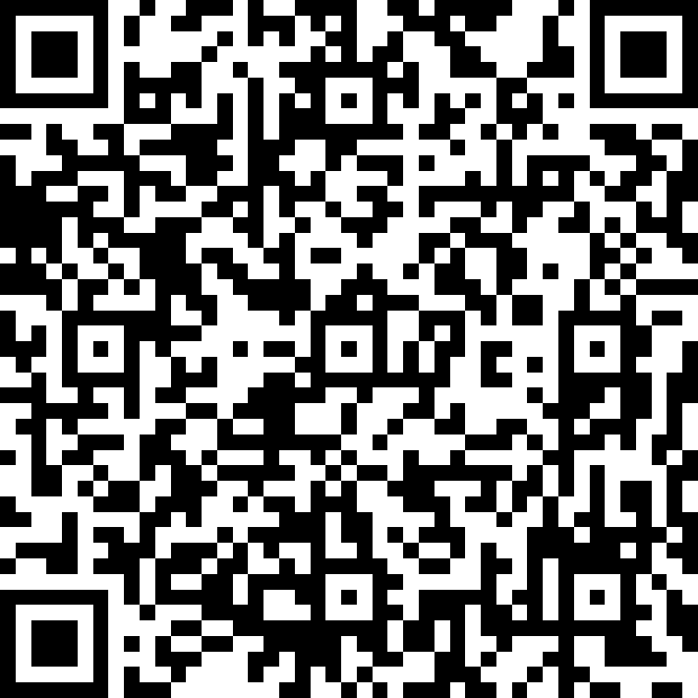
2018
QR Codes for Speaker Survey
Session #1

